Slide 1
Operating Systems

Slide 2
Chapter 3: Operating Systems
3.1 The History of Operating Systems
3.2 Operating System Architecture
3.3 Coordinating the Machine’s Activities
3.4 Handling Competition Among Processes
3.5 Security

Slide 3
Operating System
The operating system (OS) manages all of the software and hardware on the computer. It performs basic tasks such as file, memory and process management, handling input and output, and controlling peripheral devices such as disk drives and printers.

Slide 4
Functions of Operating Systems
Oversee operation of computer
Store and retrieve files
Schedule programs for execution
Coordinate the execution of programs

Slide 5
Evolution of Shared Computing
Batch processing
Interactive processing
Requires real-time processing
Time-sharing/Multitasking
Implemented by Multiprogramming
Multiprocessor machines

Slide 6
Evolution of Shared Computing
Batch processing :
Batch processing is the method computers use to periodically complete high-volume, repetitive data jobs. Certain data processing tasks, such as backups, filtering, and sorting, can be compute intensive and inefficient to run on individual data transactions.
Interactive processing :
It is the process of interacting directly with a program and/or data for immediately modifying, retrieving and/or displaying information.
Multi-tasking/time sharing :
In computing, multitasking is the concurrent execution of multiple tasks (also known as processes) over a certain period of time.

Slide 7
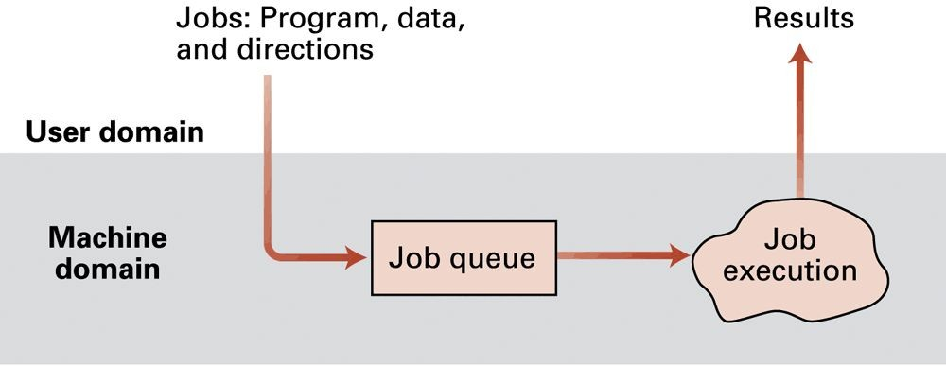
Figure 3.1 Batch processing

Slide 8
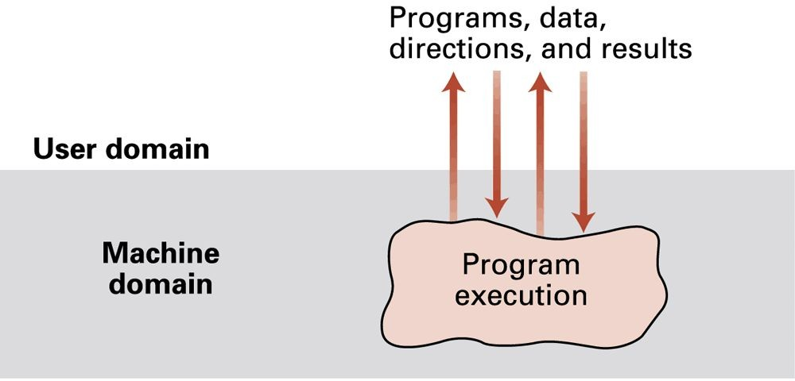
Figure 3.2 Interactive processing

Slide 9
Types of Software
Application software
Performs specific tasks for users
System software
Provides infrastructure for application software
Consists of operating system and utility software

Slide 10
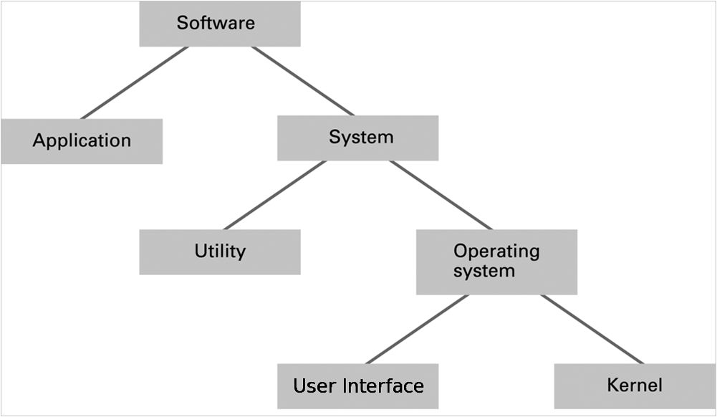
Figure 3.3 Software classification

Slide 11
Operating System Components
1. User interface (UI)
2. Kernel
User Interface: The user interface (UI) is the point of human-computer interaction and communication in a device. This can include display screens, keyboards, a mouse and the appearance of a desktop. It is also the way through which a user interacts with an application or a website.
Text based (Shell)
Graphical user interface (GUI)
Scheduler and dispatcher

Slide 12
Operating System Components
Kernel: The kernel is a core component of an operating system and serves as the main interface between the computer's physical hardware and the processes running on it. The kernel enables multiple applications to share hardware resources by providing access to CPU, memory, disk I/O, and networking.
File manager
Device drivers
Memory manager
Scheduler and dispatcher

Slide 13
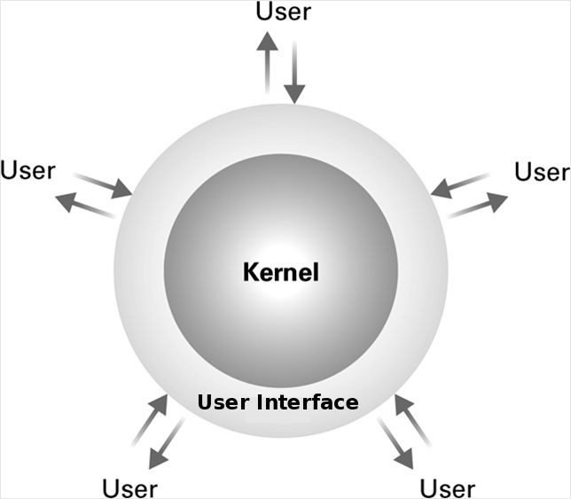
Figure 3.4 The user interface act as an intermediary between users and the operating system kernel

Slide 14
File Manager
Directory (or Folder): A user-created bundle of files and other directories (subdirectories)
Directory Path: A sequence of directories within directories

Slide 15
Memory Manager
Allocates space in main memory
May create the illusion that the machine has more memory than it actually does (virtual memory) by playing a “shell game” in which blocks of data (pages) are shifted back and forth between main memory and mass storage

Slide 16
Getting it Started (Bootstrapping)
Boot loader: A boot loader, also called a boot manager, is a small program that places the operating system (OS) of a computer into memory. Eg firmware.
Run by the CPU when power is turned on
Transfers operating system from mass storage to main memory
Executes jump to operating system

Slide 17
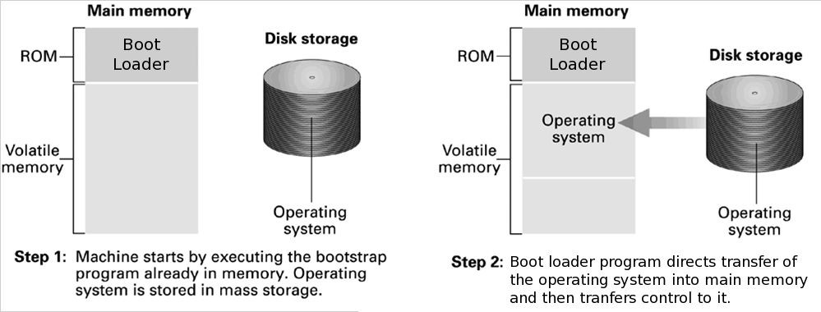
Figure 3.5 The booting process

Slide 18
Processes
Process: The activity of executing a program
Process State: Current status of the activity
Program counter
General purpose registers
Related portion of main memory

Slide 19
Process Administration
Scheduler: Adds new processes to the process table and removes completed processes from the process table
Dispatcher: A dispatcher refers to a module that provides the control of the CPU to that process that gets selected by the short term-scheduler.
– The end of a time slice is signaled by an interrupt.

Slide 20
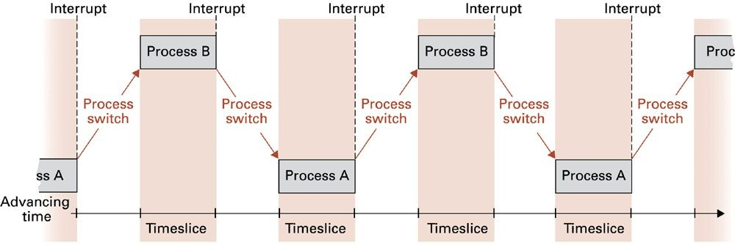
Figure 3.6 Time-sharing between process A and process B

Slide 21
Handling Competition for Resources
Semaphore: A “control flag”. A semaphore is a variable or abstract data type used to control access to a common resource by multiple threads and avoid critical section problems in a concurrent system such as a multitasking operating system.
Critical Region: A group of instructions that should be executed by only one process at a time. (That part of the program which accesses the shared memory or file is called the critical region or critical section.)
Mutual exclusion: Requirement for proper implementation of a critical region. It basically prevents race conditions (multiple programs trying to access the same resource at the same time).

Slide 22
Deadlock
A deadlock is a situation in which two computer programs/processes sharing the same resource are effectively preventing each other from accessing the resource, resulting in both programs ceasing to function.Conditions required for deadlock
Competition for non-sharable resources
Resources requested on a partial basis
An allocated resource can not be forcibly retrieved

Slide 23
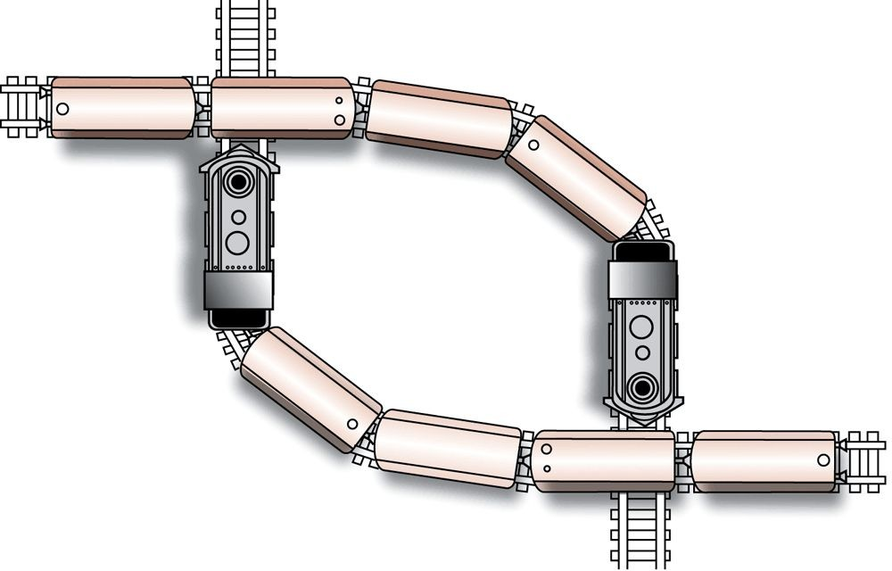
Figure 3.7 A deadlock resulting from competition for nonshareable railroad intersections

Slide 24
Security
Security :
Computer security basically is the protection of computer systems and information from harm, theft, and unauthorized use.
Attacks from outside
Problems
Insecure passwords
Sniffing software (Stealing of data via packet copying)
Counter measures
Auditing software (checking its security, quality, etc).

Slide 25
Security (continued)
Attacks from within
Problem: Unruly processes
Counter measures: Control process activities via privileged modes and privileged instructions

